Slide 1
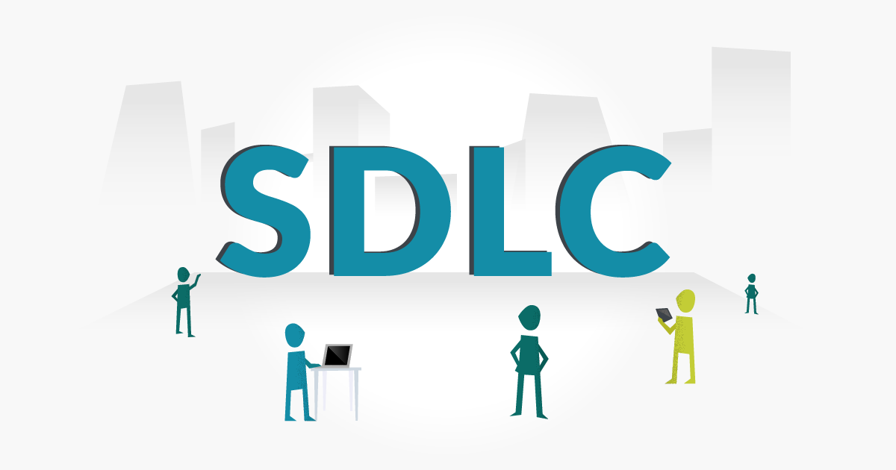

Slide 2
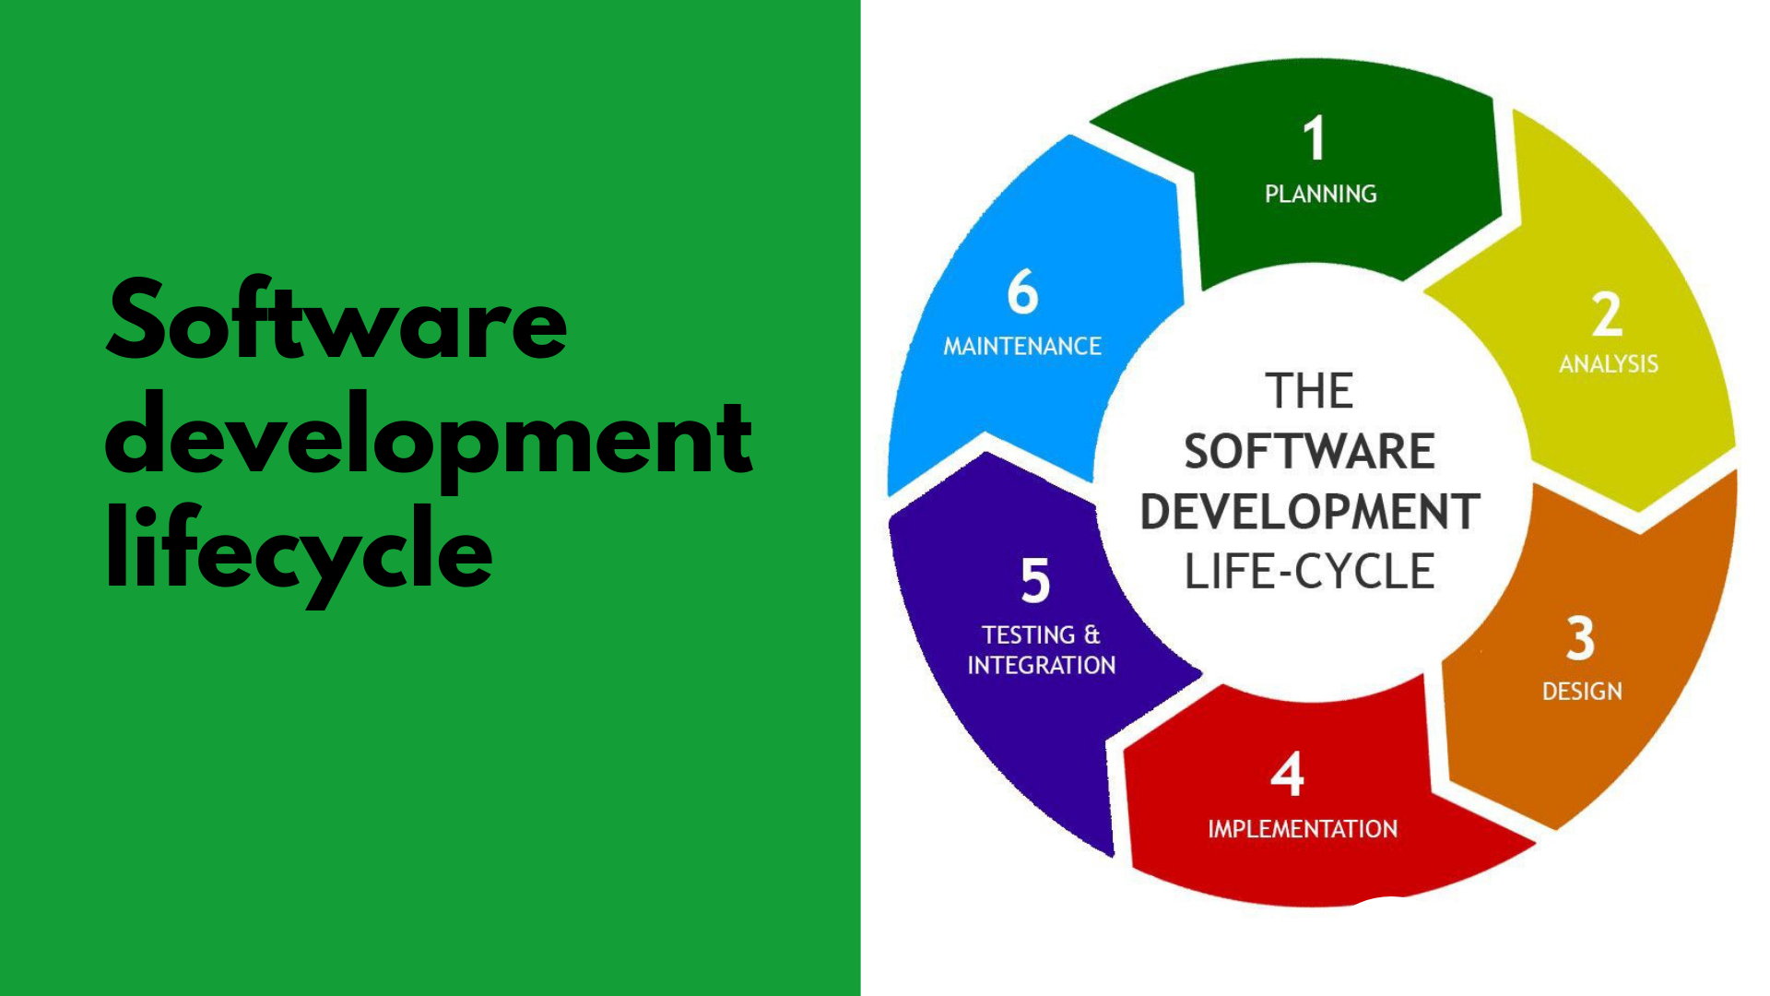

Slide 3
SDLC(Software Development Life Cycle) -SDLC is a structured process that enables the production of high-quality, low-cost software, in the shortest possible production time. -Goal is to produce superior software that meets and exceeds all customer expectations and demands.

Slide 4
-SDLC defines and outlines a detailed plan with stages, or phases, that each encompass their own process and deliverables. -Adherence to the SDLC enhances development speed and minimizes project risks and costs associated with alternative methods of production.

Slide 5
Why is SDLC important? -It provides a standardized framework that defines activities and deliverables -It aids in project planning, estimating, and scheduling -It makes project tracking and control easier -It increases visibility on all aspects of the life cycle to all stakeholders involved in the development process

Slide 6
-It increases the speed of development -It improves client relations -It decreases project risks -It decreases project management expenses and the overall cost of production

Slide 7
WATERFALL MODEL -The Waterfall Model was the first Process Model to be introduced. -It is also referred to as a linear-sequential life cycle model because it illustrates the software development process in a linear sequential flow. -It is very simple to understand and use. -The whole process of software development is divided into separate phases. -Any phase in the development process begins only if the previous phase is complete, the phases do not overlap. -The outcome of one phase acts as the input for the next phase sequentially.

Slide 8
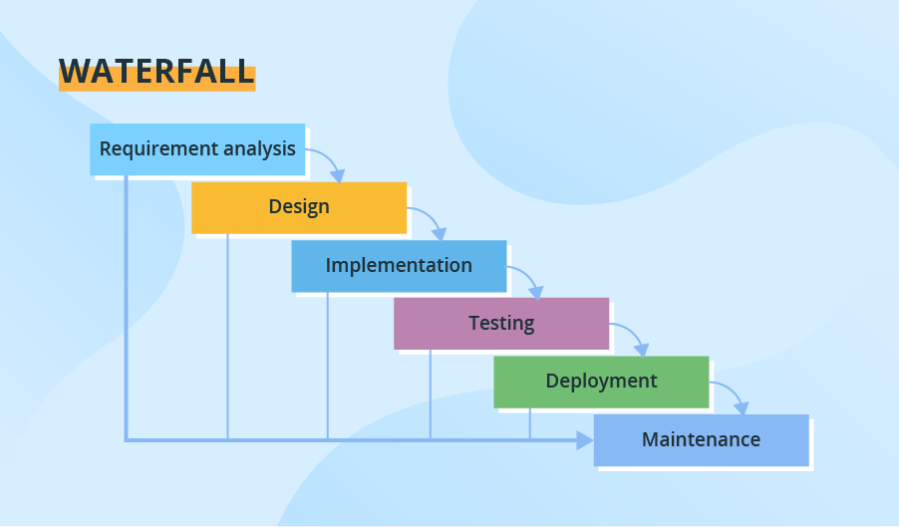

Slide 9
Requirements analysis and specification phase: -Understand the exact requirements of the customer and document them properly. -Both the customer and the software developer work together so as to document all the functions, performance, and interfacing requirement of the software. -It describes the "what" of the system to be produced and not "how." -A large document called Software Requirement Specification (SRS) document is created which contains a detailed description of what the system will do in the common.

Slide 10
Design Phase: -Aims to transform the requirements gathered in the SRS into a suitable form which permits further coding in a programming language. -It defines the overall software architecture together with high level and detailed design. -All this work is documented as a Software Design Document (SDD).

Slide 11
Implementation and unit testing: -Design is implemented. -If the SDD is complete, the implementation or coding phase proceeds smoothly, because all the information needed by software developers is contained in the SDD.

Slide 12
Integration and System Testing: -This phase is highly crucial as the quality of the end product is determined by the effectiveness of the testing carried out. -The better output will lead to satisfied customers, lower maintenance costs, and accurate results. -Unit testing determines the efficiency of individual modules. -The modules are tested for their interactions with each other and with the system.

Slide 13
Operation and maintenance phase: -Maintenance is the task performed by every user once the software has been delivered to the customer, installed, and operational.

Slide 14
Advantages: -Simple to implement also the number of resources that are required for it is minimal. -The requirements are simple and explicitly declared; they remain unchanged during the entire project development. -The start and end points for each phase is fixed, which makes it easy to cover progress. -The release date for the complete product, as well as its final cost, can be determined before development. -It gives easy to control and clarity for the customer due to a strict reporting system.

Slide 15
Disadvantages: -The risk factor is higher, so it is not suitable for more significant and complex projects. -It cannot accept the changes in requirements during development. -It becomes tough to go back to the phase.

Slide 16


Slide 17
AGILE MODEL :commitment to create software incrementally -AGILE is based on RAD model. -Agile model is the combination of iterative and incremental process models. -Designed to help a project to adapt to change requests quickly. -To facilitate quick project completion. -To accomplish this task agility is required. -Agility is achieved by fitting the process to the project, removing activities that may not be essential for a specific project. -Anything that is waste of time and effort is avoided.

Slide 18
-The requirements are decomposed into many small parts that can be incrementally developed. -The Agile model adopts Iterative development. -Each incremental part is developed over an iteration. -Each iteration is intended to be small and easily manageable and can be completed within a couple of weeks only. -At a time one iteration is planned, developed and deployed to the customers. -Long-term plans are not made.

Slide 19
-The time to complete an iteration is known as a Time Box. -Time-box refers to the maximum amount of time needed to deliver an iteration to customers. -The end date for an iteration does not change. -The central principle of the Agile model is the delivery of an increment to the customer after each Time-box.

Slide 20
-Agile offers users new versions, or releases, of software following brief periods of work. -Those brief periods of work are often called sprints.

Slide 21
Steps involve in agile SDLC models are: -Requirement gathering -Requirement Analysis -Design -Coding -Unit testing -Acceptance testing

Slide 22
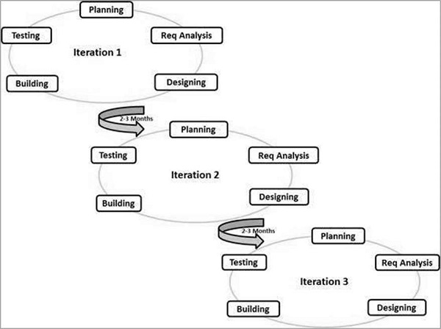
Graphical Illustration of Agile Development Model

Slide 23
The Agile Manifesto's purpose -Proponents of Agile methodologies say the four values outlined in the Agile Manifesto promote a software development process that focuses on quality by creating products that meet consumers' needs and expectations. -The 12 principles are intended to create and support a work environment that is focused on the customer, that aligns to business objectives and that can respond and pivot quickly as user needs and market forces change.

Slide 24
Four values of Agile The four core values of Agile software development as stated by the Agile Manifesto are: 1.Individuals and interactions over processes and tools. 2.Working software over comprehensive documentation. 3.Customer collaboration over contract negotiation. 4.Responding to change over following a plan.

Slide 25
The 12 principles articulated in the Agile Manifesto are: 1.Satisfying customers through early and continuous delivery of valuable work. 2.Breaking big work down into smaller tasks that can be completed quickly. 3.Recognizing that the best work emerges from self-organized teams. 4.Providing motivated individuals with the environment and support they need and trusting them to get the job done. 5.Creating processes that promote sustainable efforts. 6.Maintaining a constant pace for completed work. 7.Welcoming changing requirements, even late in a project.

Slide 26
8.Assembling the project team and business owners on a daily basis throughout the project. 9.Having the team reflect at regular intervals on how to become more effective, then tuning and adjusting behavior accordingly. 10.Measuring progress by the amount of completed work. 11.Continually seeking excellence. 12.Harnessing change for a competitive advantage.

Slide 27
Agile myths: 10: Agile has NO Planning 9: Agile has NO Documentation 8: There is No End to Development 7: There is NO Long-Term Planning 6: Daily Standup & Solutions 5: There are No Requirements Needed 4: There is No Focus on Quality 3: Agile is Faster 2: Agile is Better! 1: Agile Has No Structure

Slide 28
What are the three biggest challenges of Agile project management? -Resistance to change is a common pitfall. -Reluctant to try out new workflows. -Lack of support from management and team members.

Slide 29
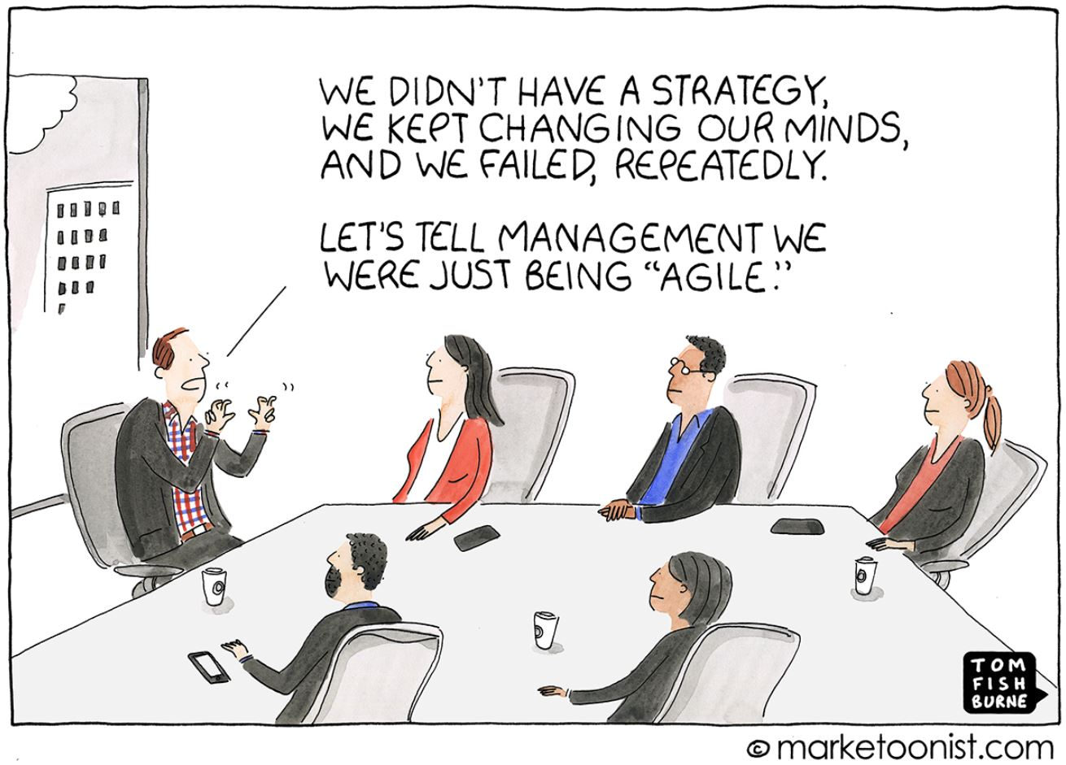

Slide 30
WHEN TO USE AGILE? It is best to use when a project has one or more of the following conditions: -Uncertainty Particularly in requirements and changing conditions -Complexity content, integration, stakeholder mgmt., solution -Innovation New technology, content or system -Urgent High priority, short timeline

Slide 31
When is project management considered truly Agile? -Transparency -Customer focus -Adaptability -Sense of ownership (shared leadership) Continuous improvement

Slide 32
Who uses Agile project management? -Originally created for software development. Other users: -Marketers -Universities -Military -Automotive industry Many organizations can benefit from Agile project management, and it’s simple to set up and utilize.

Slide 33
Agile’s Popular Methodologies Scrum: Characterized by cycles or stages of development, known as sprints, and by the maximization of development time for a software product. Kanban: A workflow management method that aims to visualize work and maximize efficiency. It exists on a board or table that is divided into columns that show every flow of the software product.

Slide 34
Extreme Programming (XP):- A methodology that takes good software development practices to the extreme. -Code reviews become pair programming; programmers constantly review each other’s code, -Unit testing applies to all code. -Extreme programming values a flat management structure and constant communication with both the client and within the programming team.

Slide 35
Lean Development: -Focuses on seven fundamental principles. -Deleting the things that do not matter, quality development, creating knowledge, differing commitments, fast delivery, respecting the team, and optimizing the whole. Crystal: A family of different agile methodologies that includes categories depending on the size of teams. Crystal clear (up to an 8-person team), crystal orange (20 to 50), and crystal red (50 to 1000) Focuses on delivering the best possible software development process.

Slide 36
Adaptive Project Framework (APF):- APF is the project management methodology where teams work in stages and analyze each one.

Slide 37
Advantages: -Working through Pair programming produce well written compact programs which have fewer errors as compared to programmers working alone. -It reduces total development time of the whole project. -Customer representatives get the idea of updated software products after each iteration. So, it is easy to change any requirement if needed.

Slide 38
Disadvantages: -Due to lack of formal documents, it creates confusion and important decisions taken during different phases; can be misinterpreted at any time by different team members. -Due to the absence of proper documentation, when the project completes and the developers are assigned to another project, maintenance of the developed project can become a problem.

Slide 39
Agile vs Waterfall -Waterfall is a Linear Sequential Life Cycle Model, whereas Agile is a continuous iteration of development and testing in the software development process. -The Agile methodology is known for its flexibility, whereas Waterfall is a structured software development methodology. -Agile follows an incremental approach, whereas the Waterfall is a sequential design process.

Slide 40
-Agile performs testing concurrently with software development, whereas in Waterfall methodology, testing comes after the “Build” phase. -Agile allows changes in project development requirements, whereas Waterfall has no scope of changing the requirements once the project development starts.

